Slide 1

Automatic Speech Recognition
Stephen McLaughlin
PhD Student

Slide 2
Credit: Geitgey 2016
Stephen McLaughlin / @SteveMcLaugh
Notes:
Point: A binary classifier is the first step to understanding more complex speech analysis.
credit:
https://medium.com/@ageitgey/machine-learning-is-fun-part-6-how-to-do-speech-recognition-with-deep-learning-28293c162f7a

Slide 3
Credit: Geitgey 2016
Stephen McLaughlin / @SteveMcLaugh
Notes:
Point: A binary classifier is the first step to understanding more complex speech analysis.
credit:
https://medium.com/@ageitgey/machine-learning-is-fun-part-6-how-to-do-speech-recognition-with-deep-learning-28293c162f7a

Slide 4
Speech to text: 2 paradigms
Phonetics
allows search outside the standard lexicon (new words and proper nouns)
quick initial processing (relatively few phonemes in English)
LVCSR (Large Vocabulary Continuous Speech Recognition)
typically more accurate
misses “non-standard” vocabulary and grammar
Stephen McLaughlin / @SteveMcLaugh

Slide 5
LVCSR (Large Vocabulary Continuous Speech Recognition)
Audio
Phonetic model
Language model
Text/Lattice
Stephen McLaughlin / @SteveMcLaugh

Slide 6
Commercial ASR services
IBM Watson: 1000 mins/mo. free, then $0.02/min
Google Cloud Speech API: $0.024/min
Bing Speech API: $0.09–0.15/min
Pop Up Archive: $0.20–0.25/min
Facebook’s Wit.ai: Free, mystery rate limit. Data stored & made public.
Stephen McLaughlin / @SteveMcLaugh
Notes:
Watson: 1,000 hours is $1200
I initially had a political aversion to these services, in a way ... because none of them will be there forever, and for libraries in particular that’s a big consideration. There’s value in predictability and persistence over time.

Slide 7

Stephen McLaughlin / @SteveMcLaugh

Slide 8
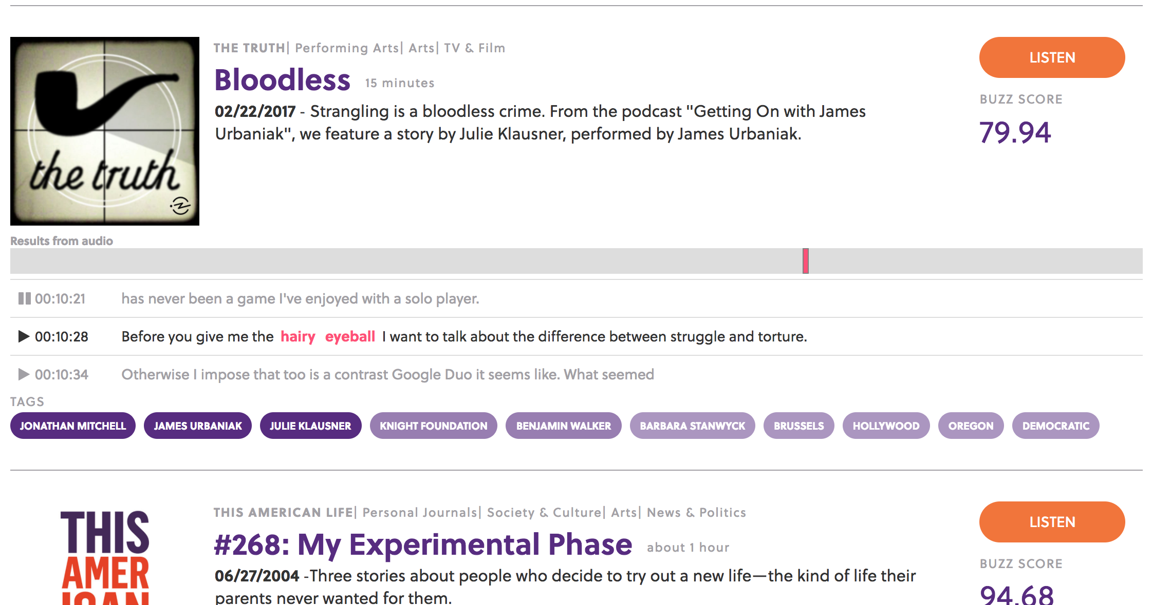
Audiosear.ch
Stephen McLaughlin / @SteveMcLaugh

Slide 9
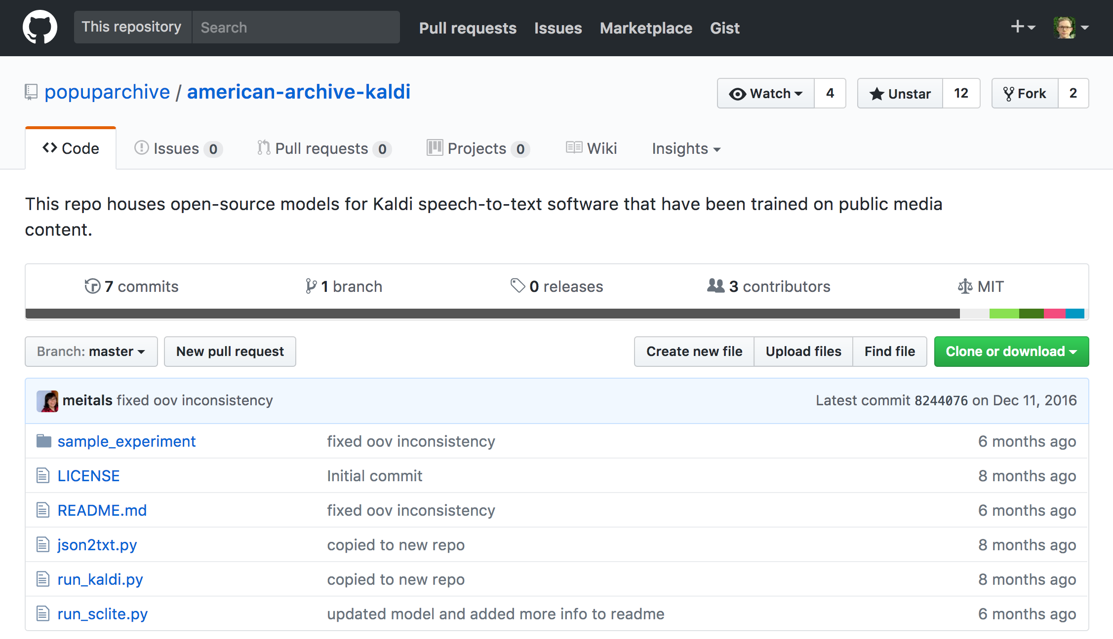
Stephen McLaughlin / @SteveMcLaugh

Slide 10
PocketSphinx
Fast, easy, decent output
Vocabulary: 134,723 words
C, Apache License 2.0
Python wrapper: speech_recognition (github.com/Uberi/speech_recognition)
Slow, difficult, very decent output
Pop Up Archive vocabulary: 145,123 words
C++, Apache License 2.0
Stephen McLaughlin / @SteveMcLaugh
Notes:
“PocketSphinx is a lightweight speech recognition engine, specifically tuned for handheld and mobile devices”
SphinxBase
“Sphinx4 is a pure Java speech recognition library.”

Slide 11
{ "time": 23.74, "word": "the", "duration": "0.08" },
{ "time": 23.82, "word": "sense", "duration": "0.41" },
{ "time": 24.23, "word": "that", "duration": "0.14” },
{ "time": 24.37, "word": "shelly", "duration": "0.38" },
{ "time": 24.75, "word": "regarded", "duration": "0.42” },
{ "time": 25.17, "word": "himself", "duration": "0.38" },
{ "time": 25.55, "word": "as," "duration": "0.14” },
{ "time": 25.69, "word": "a", "duration": "0.05” },
{ "time": 25.74, "word": "poet", "duration": "0.39” },
Stephen McLaughlin / @SteveMcLaugh

Slide 12

David Antin, UPenn seminar, March 16, 2004 PocketSphinx Kaldi + PUA model
stores over the floodwaters was over guns constitutes a leopold because it is really a coleman the same way that go goals famous work good souls was titled by google in russian flamboyantly on the title page that's also a pall of russia in that sense i may regard myself as a poet i do not regard myself the poet is a bullet in the sense that shall we regarded himself was a poet when he wrote the stove and home to the skylark i do not regard myself as being close to john keats as opposed i don't even regardless of who's been close that alexander popov support than either famously this miserable throb revolt and robert frost was my idea of a kind of poetry or was interested him however i did regard sock produces decided what that i'm a goner is as a possibility that socrates and the tinge line on most of the evidence would can gianni was a surprise to provence bought this organism that confronted the rug on
so was over before the waters was offered as constitutionally appalled because it's usually a poem in the same way that goggles famous work the dead souls was titled by gogol in russian flamboyantly on the title page that sells a poem of russia in that sense and they regard myself as a poet i do not regard myself a poet as a poet in the sense that shelly regarded himself as a poet when it wrote the severe come to the skylark i do not regard myself as being close to john keats as a poet i don't even regardless of as being close to alexander pope as a poet and i are famously dismissed rubble of robert lowell and robert frost as my idea of the kind of poetry i was interested in however i didn't go as socrates as so if what that is as a possibility that of socrates and that enshrine and those as i didn't say this change time he was a suppressed relevance as socrates and that changed on could be rude boy
Stephen McLaughlin / @SteveMcLaugh
Notes:
advertise Getty DL set

Slide 13
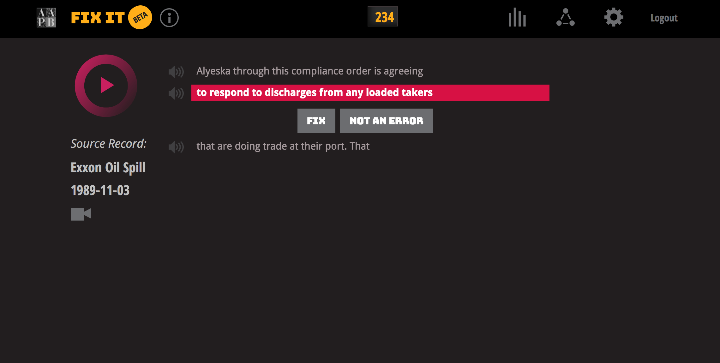
Stephen McLaughlin / @SteveMcLaugh

Slide 14
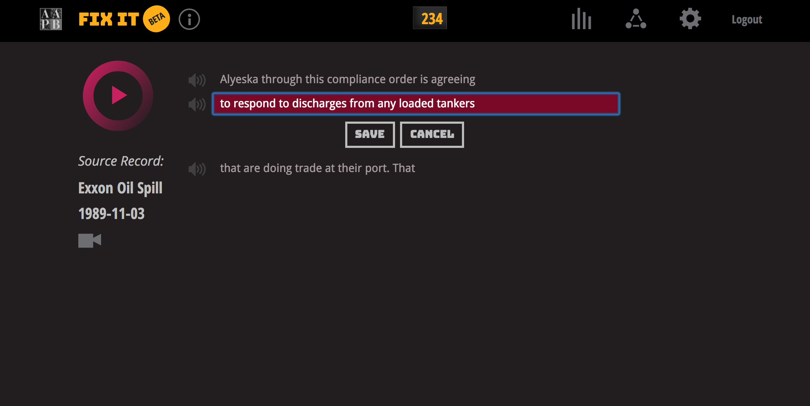
Stephen McLaughlin / @SteveMcLaugh

Slide 15
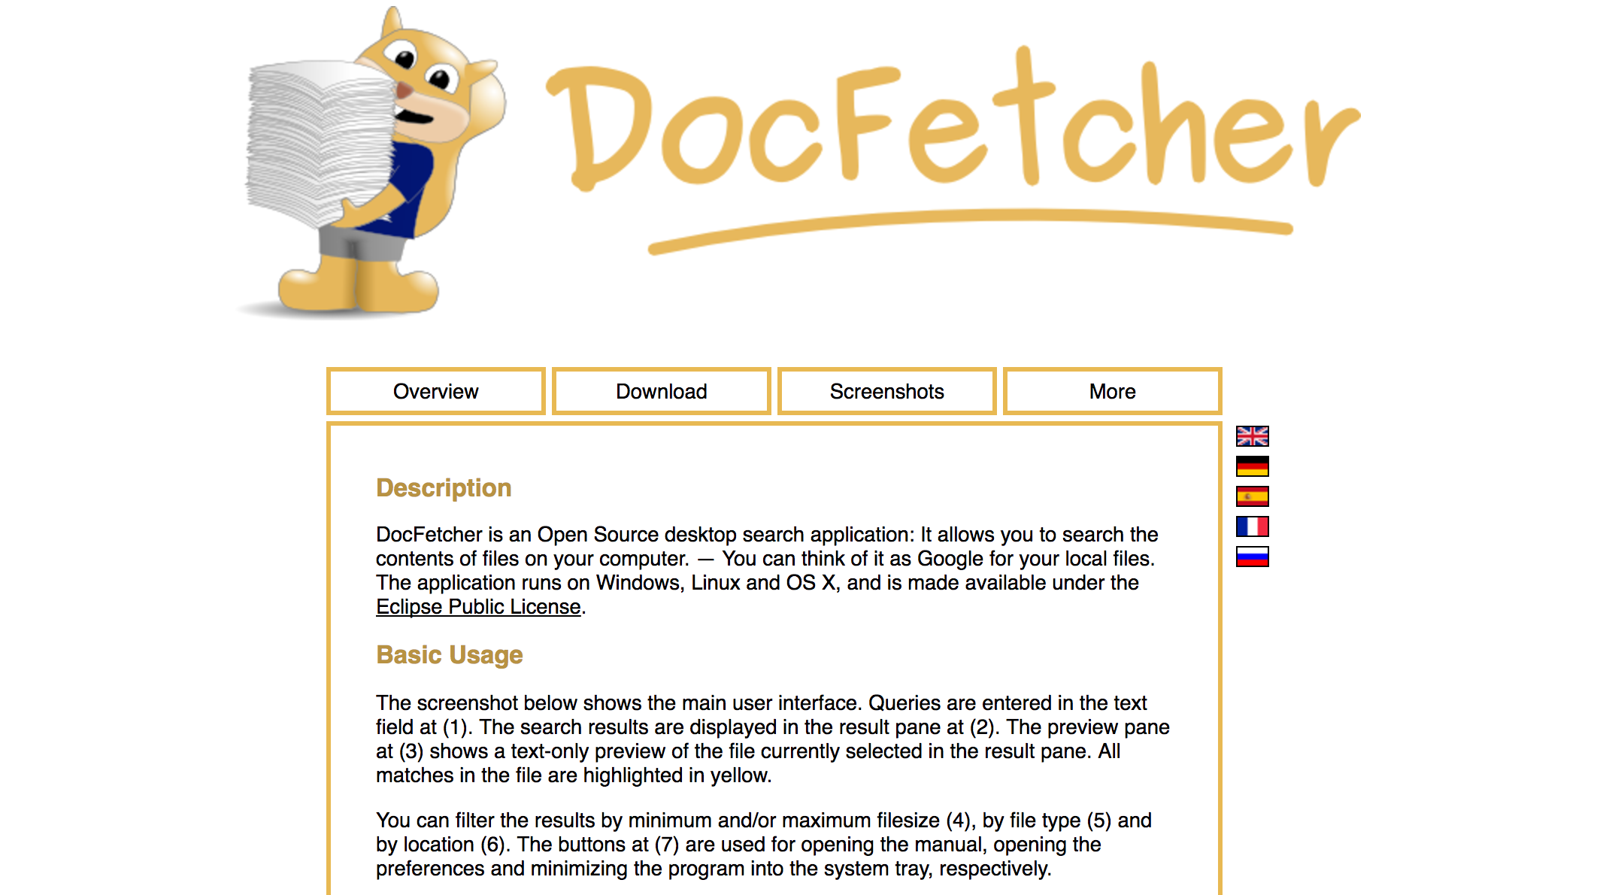
Stephen McLaughlin / @SteveMcLaugh

Slide 16
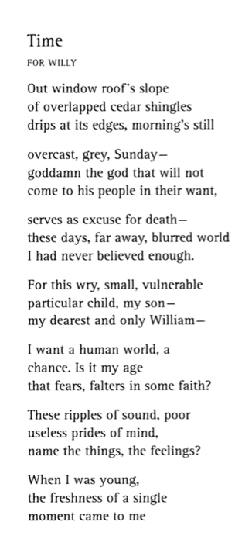
Stephen McLaughlin / @SteveMcLaugh

Slide 17
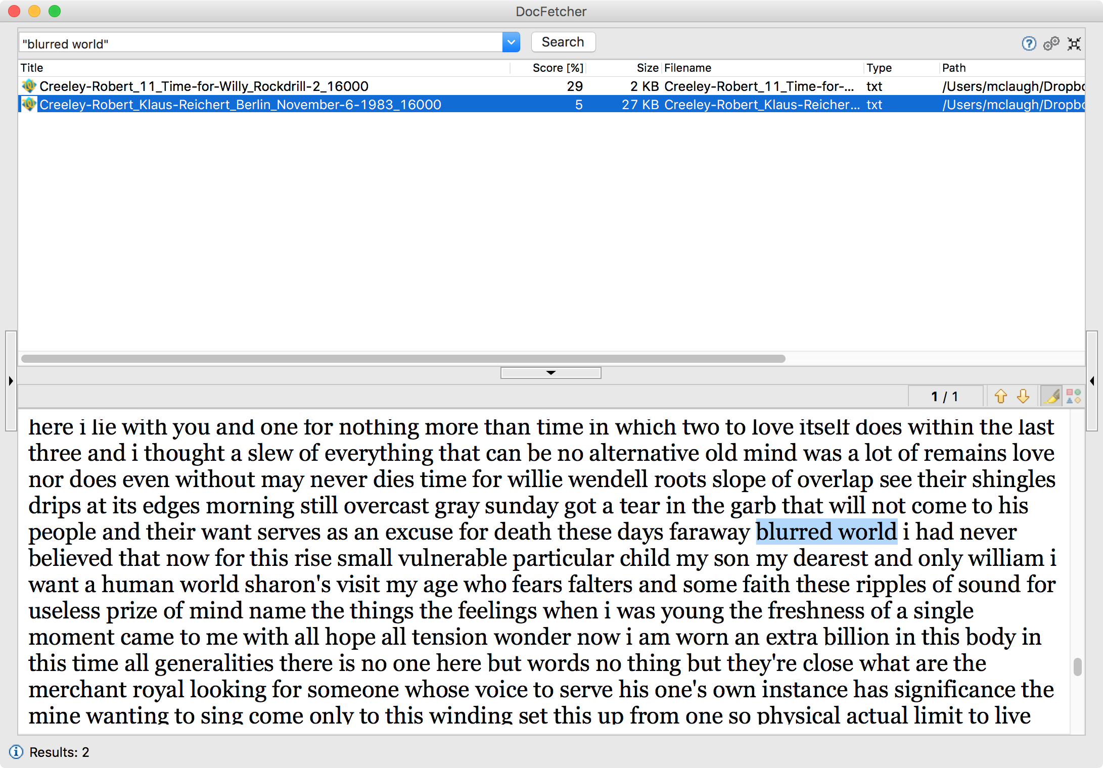
Stephen McLaughlin / @SteveMcLaugh
Notes:
- Jim’s aim: poems that were “competitive,” good enough to read repeatedly.
Source texts: Collected poems of Emily Dickinson or Joseph Conrad’s Heart of Darkness.
At the time I was feeling overwhelmed by the size of the poetry world.
An expression of hopelessness / sneering mockery.

Slide 18
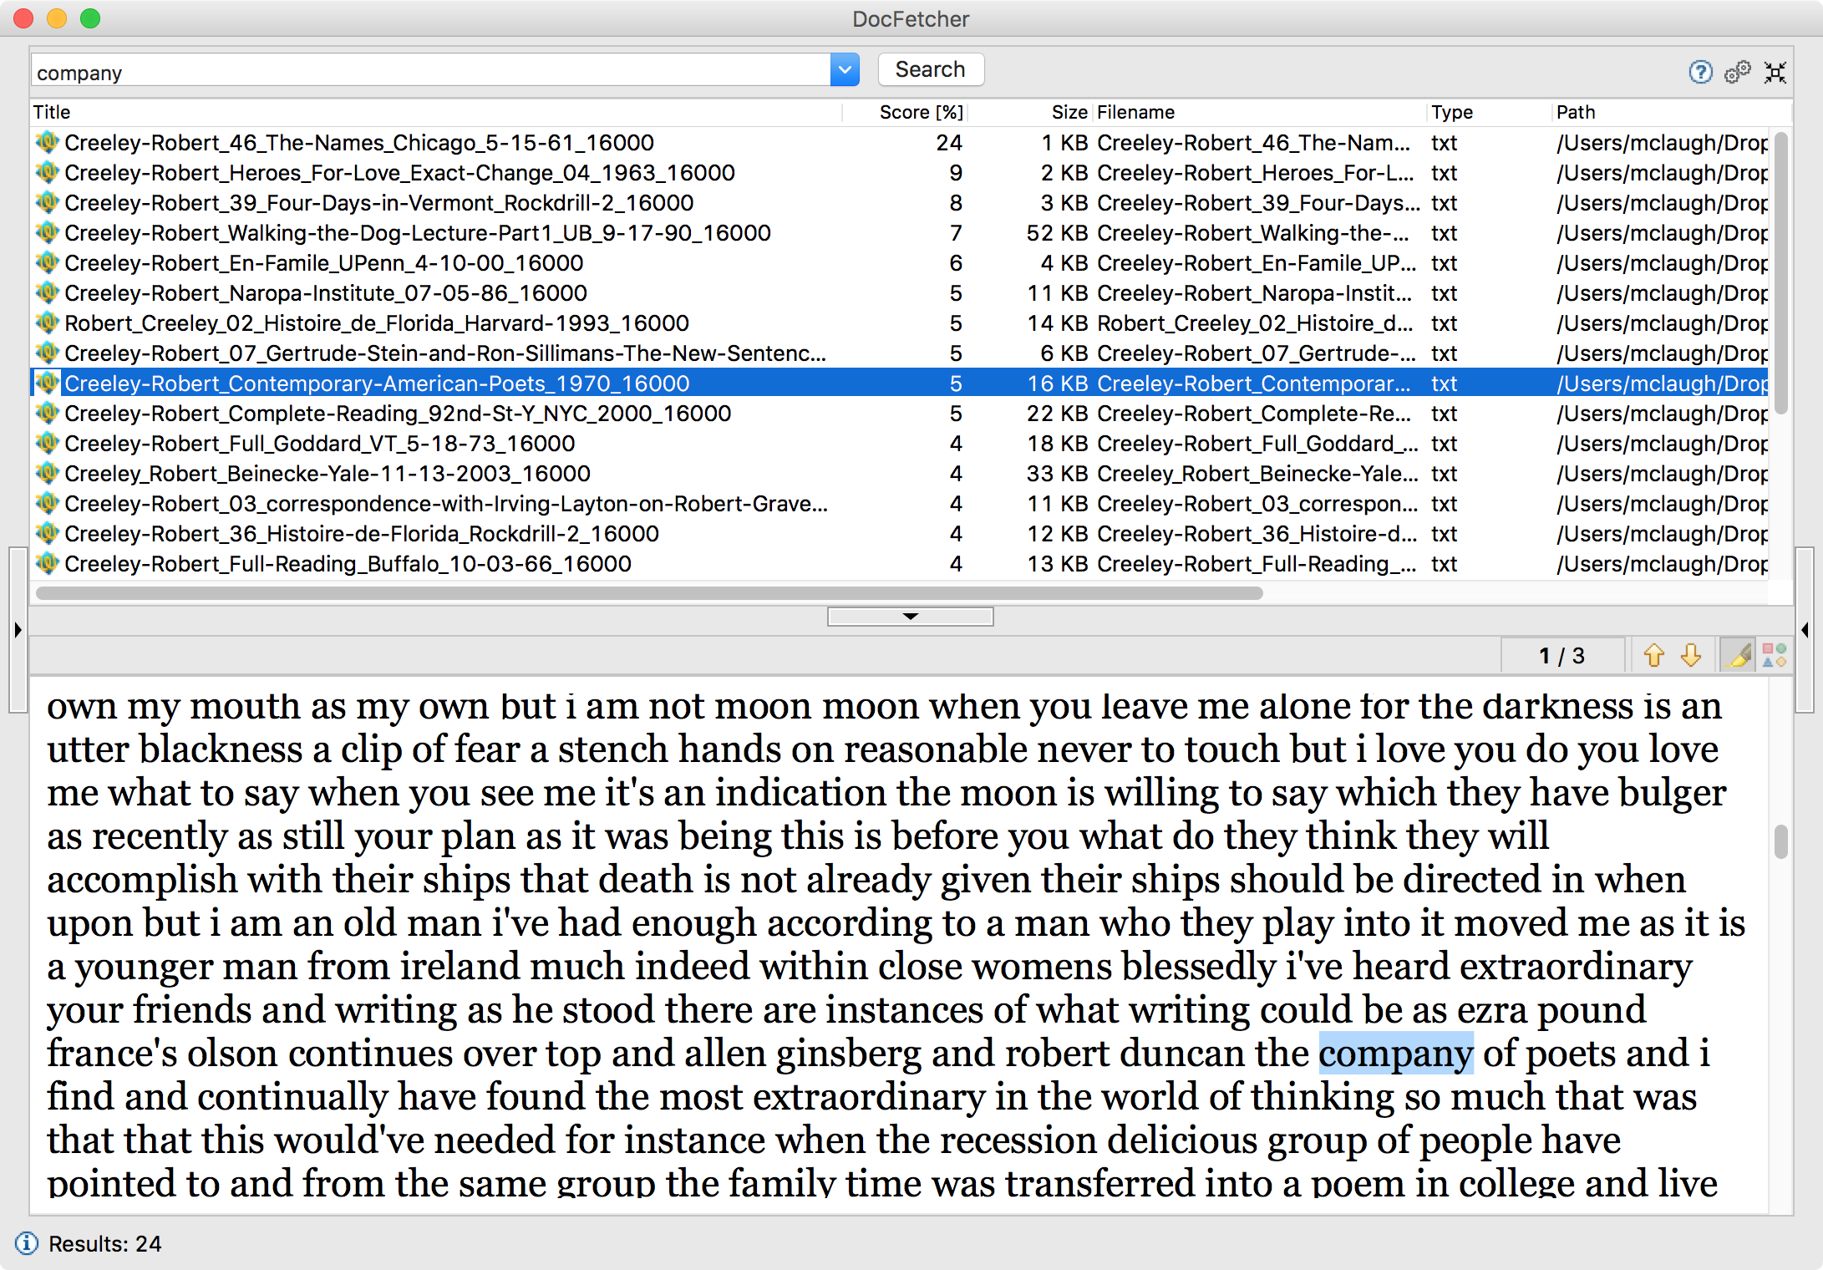
Stephen McLaughlin / @SteveMcLaugh

